Slide 1

Generative AI-Powered FAQ Response System
Welcome! Today, we'll explore a revolutionary solution that leverages the power of Generative AI to automate customer support responses, ultimately streamlining operations and improving customer satisfaction. Let's dive in.
Aaron Joel B C – 210701005
Abeshek Srikanth – 210701009
Avinash N – 210701036

Slide 2

Abstract and Problem Statement
1
Challenge
2
Impact
Managing repetitive inquiries challenge
Overwhelms staff, causes delays
Increase Productivity of Staffs by 70%
3
Goal
Efficiently handles FAQs.
Frees staff."

Slide 3
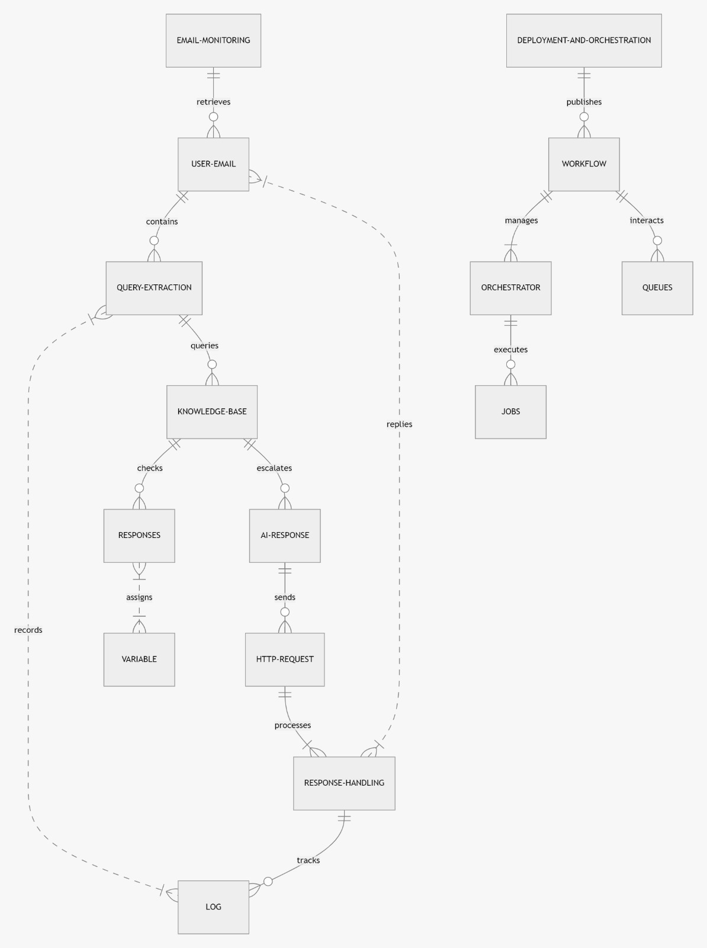
Solution and Implementation
Escalation
For queries where AI confidence is low, the system escalates the question to human operators for a more personalized response.

Slide 4
Conclusion and Future Directions
Conclusion
This innovative solution automates customer support, significantly reducing the workload on staff and ensuring timely, accurate responses to frequently asked questions.
Impact
By leveraging AI and RPA, this system transforms customer support, improves efficiency, and drives increased customer satisfaction.
Future Directions
Future plans include enhancing the AI model's accuracy, expanding support to multiple channels, and implementing dynamic learning to continuously improve the system's knowledge base.

